Slide 1
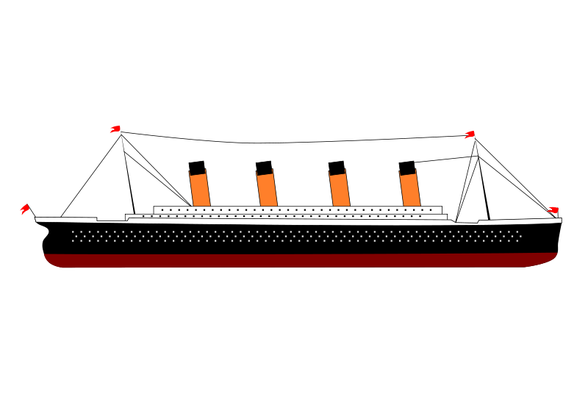
Titanic
Group 1- Children of Jupyter
Cullin Flynn, Christine Kitchens, Erika Lewars, Rick Sadowski, Kira Livingston

Slide 2


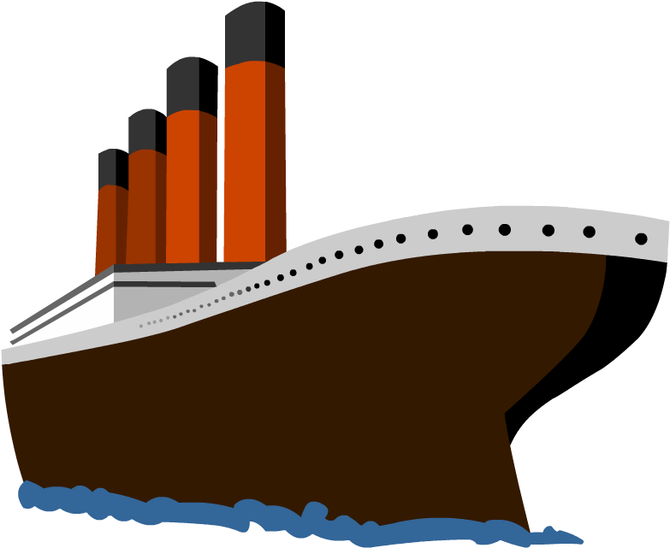


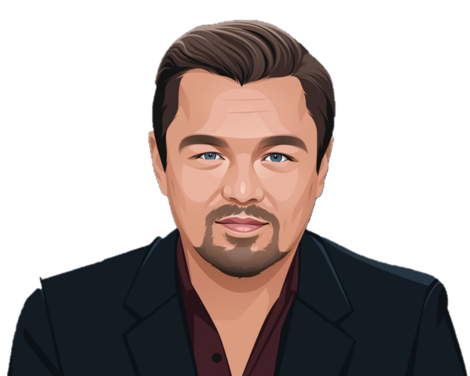


Notes:
The RMS Titanic was an iconic, heralded passenger liner that sunk over the North Atlantic ocean on April 15, 1912. When the ship - which weighed over 100 million pounds and was the largest in the world at the time - met its fate, over 68% of the passengers and crew perished; however, over 700 of the two-thousand-plus passengers were saved and survived the wreck. Survival depended on many factors, but some factors may have influenced survival more than others. In our interactive web interface, users will be able to create a fictional character on the Titanic ship, and based on information such as class, sex, and more, find out if our unique model predicts that the person would have survived or perished if they were on the Titanic's ill-fated maiden voyage!

Slide 3
The “WHY?” Questions we hope to answer with Data
What characteristics influenced the likelihood of survival in the Titanic disaster?
Which demographic groups were most likely to survive the disaster?
Given variable inputs, would a machine learning model predict survival?
Notes:
We will be using machine learning to create a model that predicts which passengers survived the Titanic shipwreck. Our team selected this topic because we wanted to obtain a deeper understanding of the tragedy and how different passenger attributes impacted their odds of survival.
We first built a machine learning model using python, pandas, then linked the database to our model using sqlalchemy.
<CLICK>
We wanted to answer what characteristics influenced the likelihood of survival in the Titanic disaster?
<CLICK>
We also wanted to know which demographic groups were most likely to survive the disaster?
<CLICK>
Finally, our favorite part of the project, building an interactive tool where a user can enter inputs, and given these variable inputs, discover if the machine learning model would predict survival.

Slide 4
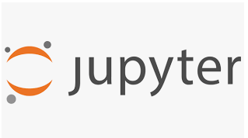

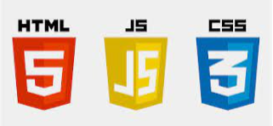






Tools/Languages USED in this project
Notes:
We used several tools and languages to complete this project.
<CLICK>
In addition to the tools we already mentioned, we built our webpage using Flask, employing HTML, JavaScript, and CSS. The model was built using jupyter notebooks and employing Python with several imports to ensure functionality of the tool. The project was housed on GitHub as we worked on it, and the database was constructed in PG Admin and linked using SQL Alchemy. Finally, statistical summaries and stunning visual displays were created using our dataset through the R programming language and through Tableau.

Slide 5
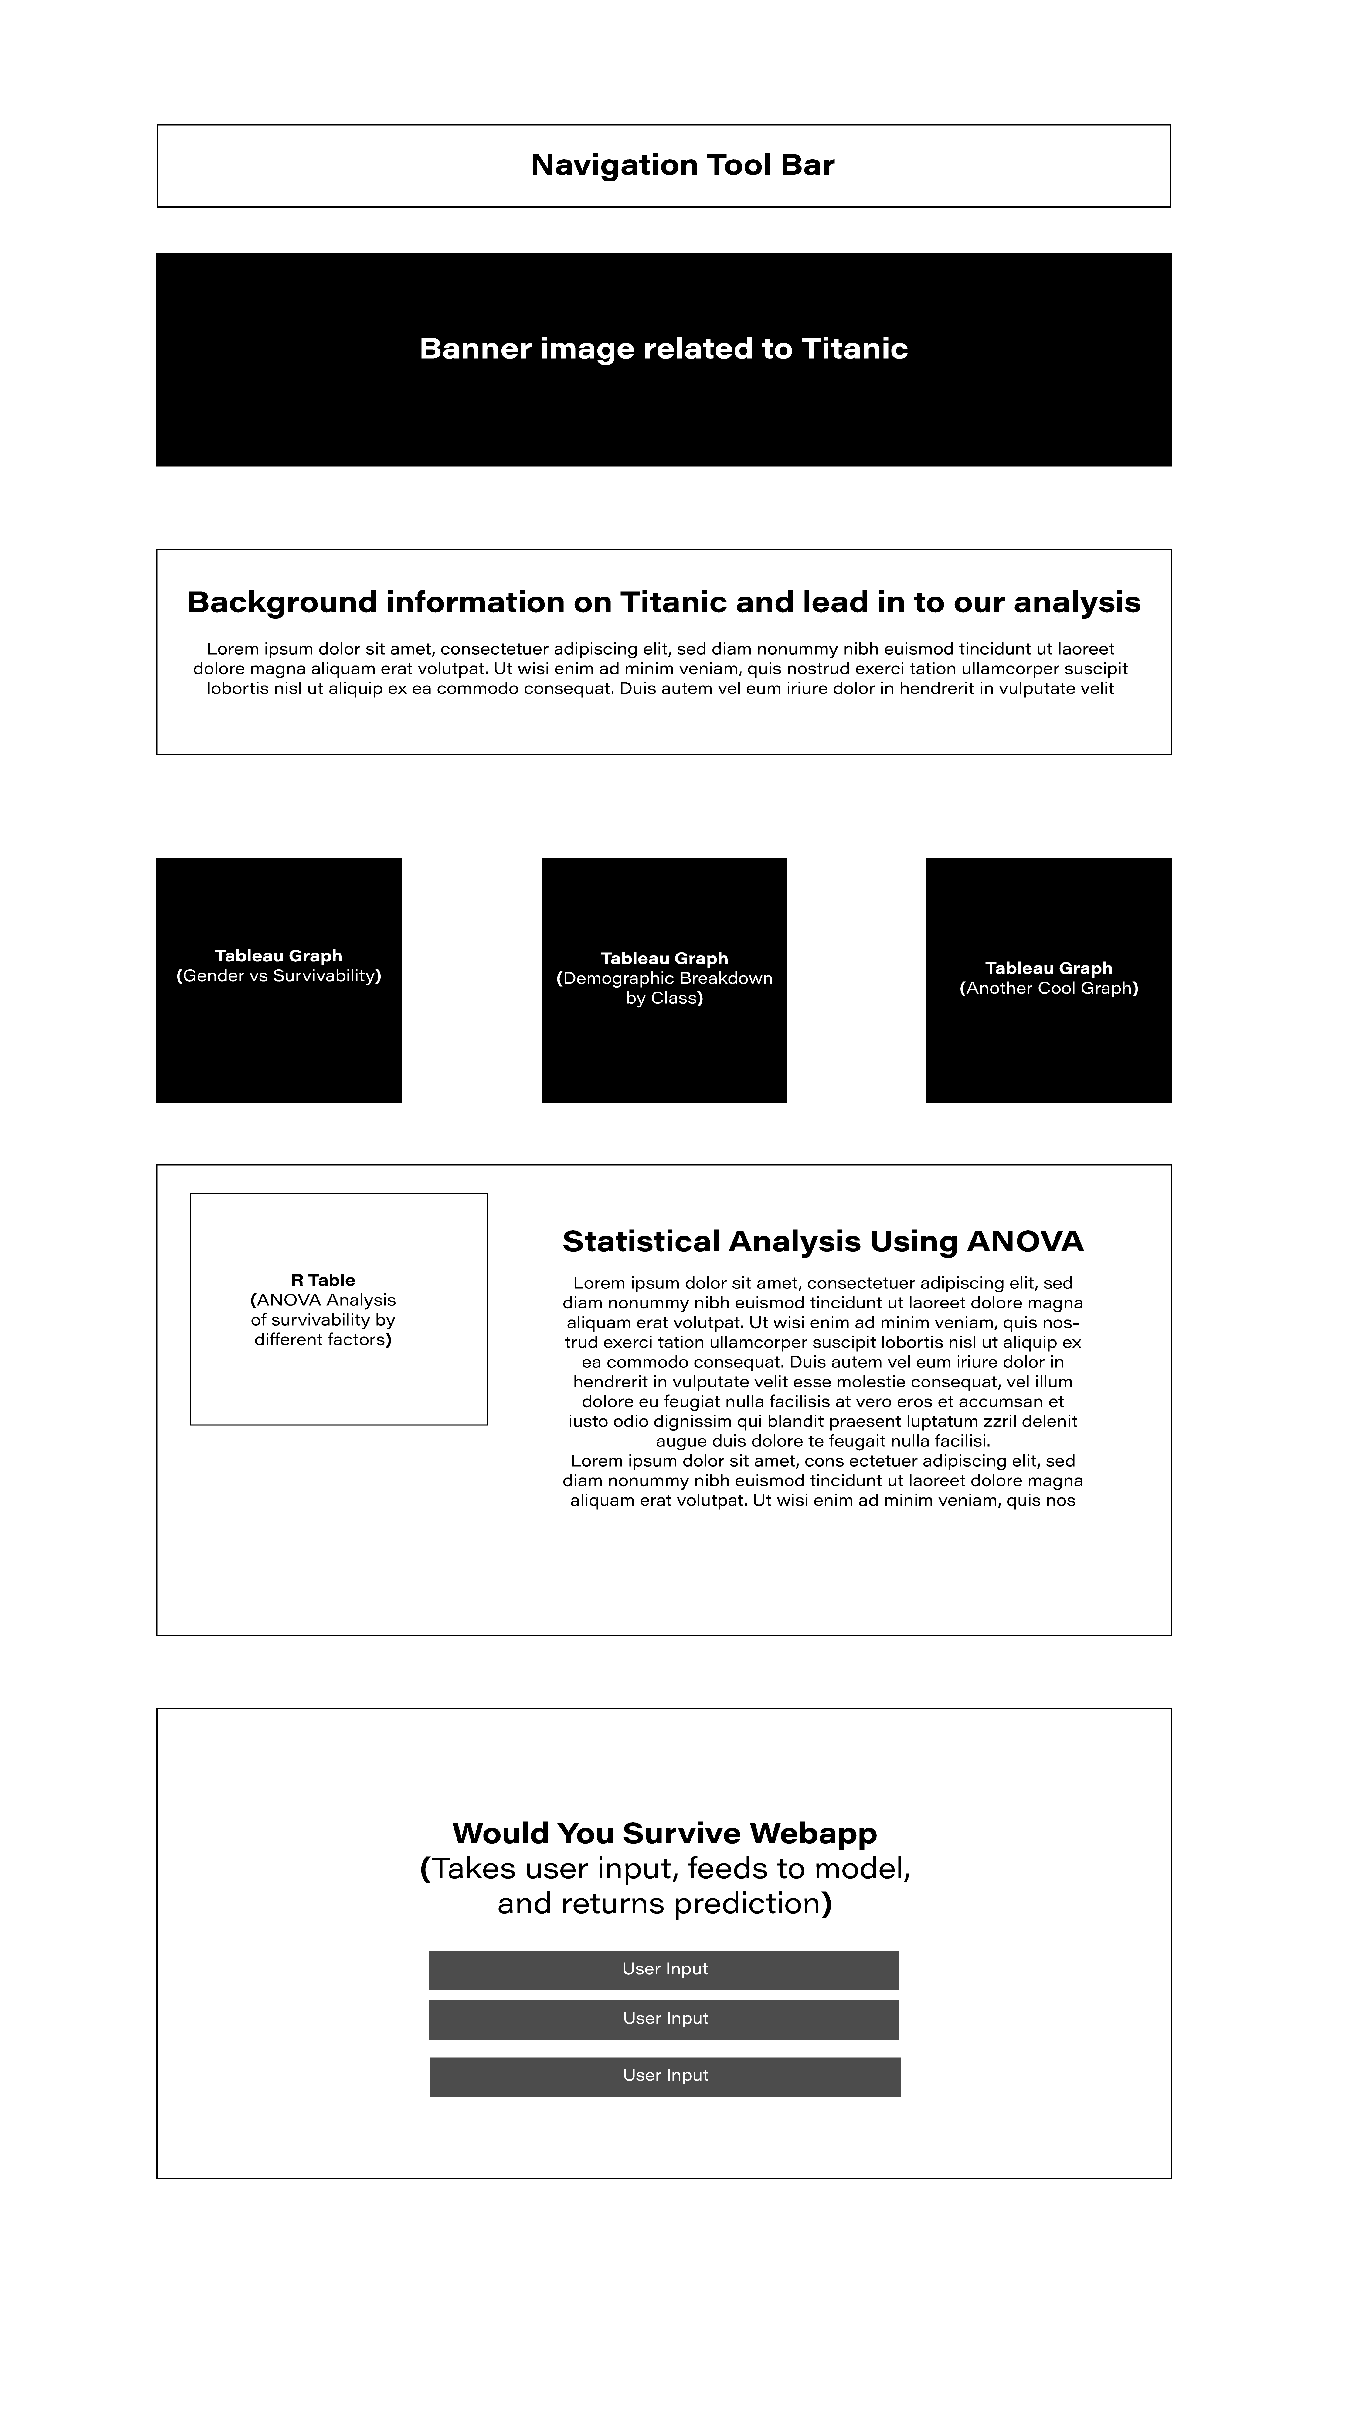
Storyboard
Notes:
Here is a conceptual design of our storyboard. This served as a wonderful tool for us to have as a reference as we each built our respective parts of the webpage.

Slide 6

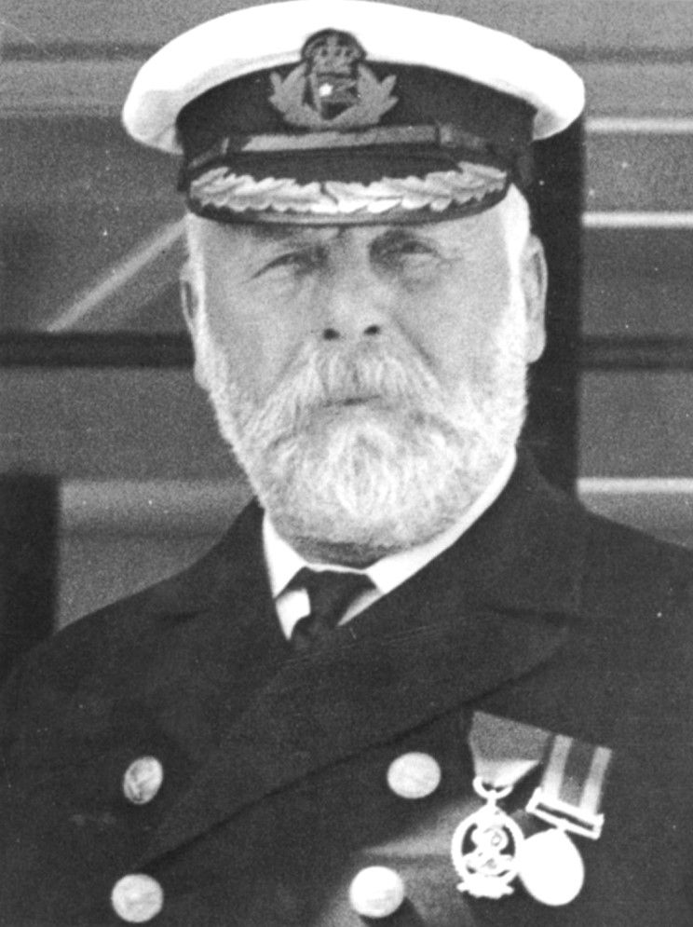
Data
After discussing several titanic resource files, we decided to download the dataset through the r package “stablelearner”.
This dataset seemed to be the most complete source by including all passengers, including the crew on board the RMS Titanic.
Notes:
<READ SLIDE>

Slide 7
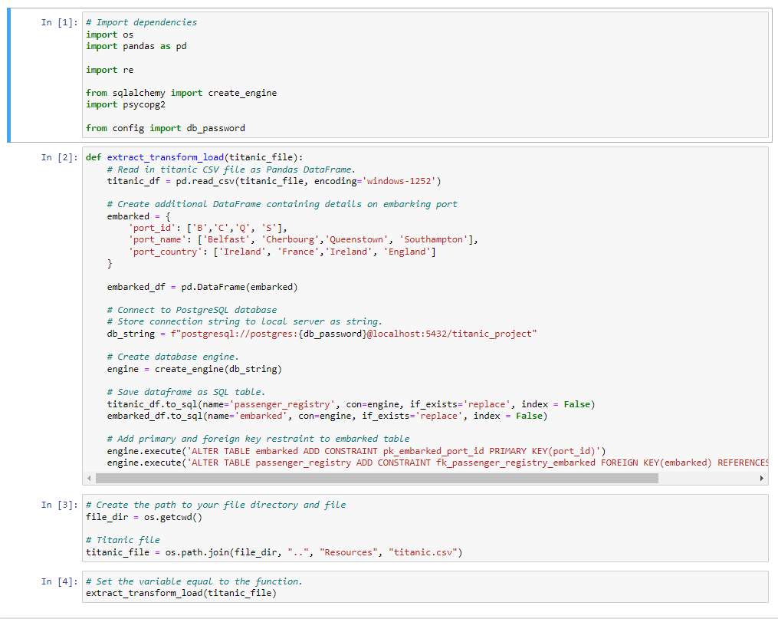
Notes:
We chose to upload our database into a PostGres database via PgAdmin and SQL Alchemy. We created a new database called ‘titanic project’ on the postgres server. Initially, we tried to directly import the titanic.csv file into the database, but faced issues around handling special characters in passengers’ names (e.g. “ ’ ”). Rather than modify the csv directly, we decided to use SQL Alchemy to facilitate the import of the data into the database since it would handle those issues for us. We followed a similar framework as outlined in our ETL module in class. We also created a second table providing more descriptive information about the port of embarkment since the original dataset only uses single characters in the ‘embarked’ column, which isn’t intuitive to the average reader. We also added primary and foreign key restraints to establish the relationship between these two tables.

Slide 8
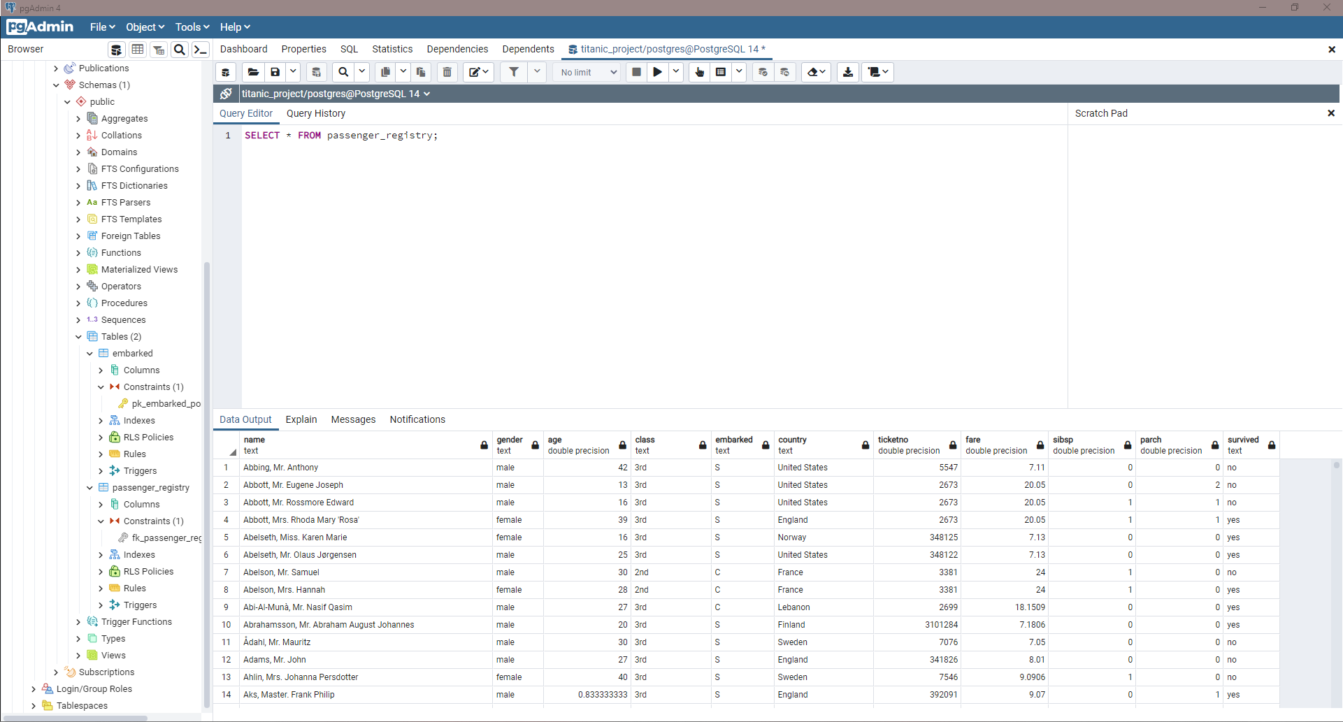
Notes:
Once the SQL Alchemy script from the Jupyter Notebook was executed, we were able to view and manipulate both tables from within pgAdmin. From here, we set up a connection between the database and our model script.

Slide 9
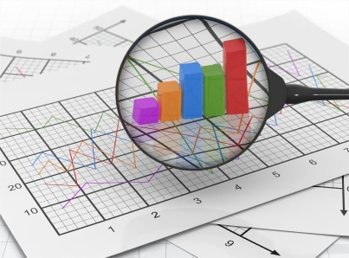
Exploration of the Data Set
Scrubbing the data
Passenger Classes and Crew Considerations
Dropping Unneeded columns
Feeding Male/Female into the model
Country of Nationality
Notes:
Exploration of the Data Set
<CLICK>
Several situations existed that we needed to address prior to feeding the data frame in to the machine-learning model.
<CLICK>
Class, in the dataset, was first, second, third, and then several different crew roles. We used pandas to change all crew to “crew” because the purpose of our model is not to differentiate results by crew type, and minimizing the values will help us from having too many values.
<CLICK>
We then dropped the ‘name’ and ‘ticktetno’ columns because we determined these values are not needed for our analysis.
<CLICK>
Next, we set the gender column to a numerical “1” for male and “0” for female to help with our model.
<CLICK>
Then, we noticed that the country of nationality for the passengers came from several dozen countries, with many having only a few passengers. To address this, we grouped all countries with less than 50 passengers by continent, creating 12 buckets for country.

Slide 10
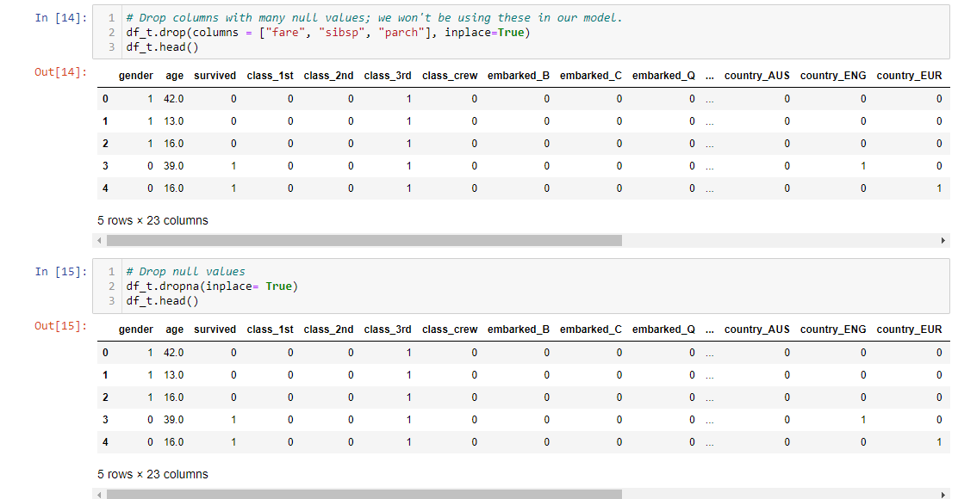
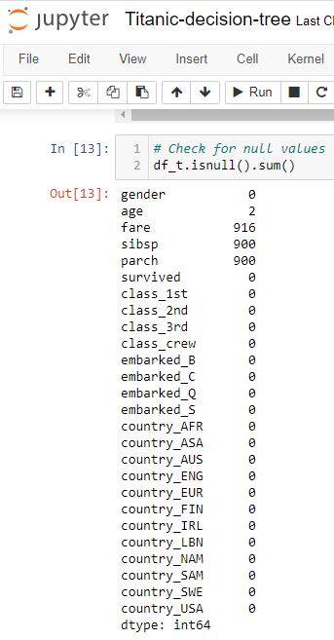
How to handle Null Values
What would you do?
Notes:
We had an interesting concern around null values, as the “parch” and “sibling” columns, indicating if a passenger had relatives on the boat, contained 900 null values out of about 2,200 records. Additionally, the “fare” column had 916 null values.
Our choices were to remove these columns completely, which means that we won’t do analysis on these columns; or, remove these many rows with no data and everything else that goes with it, limiting the number of records in the dataset from 2,200 to 1,300.
<CLICK>
So now we ask what you would have done? Feel free to come off mute and tell us which choice you think is best? (Take responses)
<CLICK>
We ultimately decided to remove the columns and perform the analysis on the larger dataset with the remaining columns. Due to the dataset of Titanic passengers being relatively small for machine learning already, removing some columns and doing a more robust on the remaining columns was more desirable.

Slide 11
Recommendations FOR FURTHER EXPLORATION
Import additional disasters to the interactive webpage
Utilize the decision tree or random forest machine learning to determine survival based on disaster
Have disaster be a option users can select
Notes:
<READ SLIDE>

Slide 12

Now for the fun part… The interactive webpage!
DATA ANALYSIS
BOOTCAMP

